Slide 1
Bottom-up Approaches to Approximate Inference and Learning
Andrew Gelfand
Final Defense
April 10, 2014

Slide 2
Acknowledgements
Cluster Cumulants
Rina Dechter
Alex Ihler
Max Welling
Misha Chertkov
Kalev Kask, Jinwoo Shin
Dechter, Ihler & Welling labs
BEEM
BP for Weighted Matchings
Inferning
Tree Robustness
Herding
Elimination Orderings
Notes:
In my time at UCI I have worked on a lot of different and exciting projects
Beginning with bucket elimination using external memory (BEEM) with rina and kalev,
to herding with Max and more recently to weighted matching work with Misha and inferning work with Alex and Rina
Not only would I have been unable to explore so many interesting topics without such great support, but I also would not have learned as much without your differing but complimentary views on science and ai and machine learning research

Slide 3
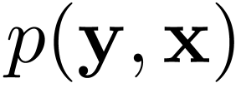
Statistical Modeling
RGB image with L pixels
Labeling of L pixels
How do we represent ?
How do we learn from data?
How do we predict, e.g. compute ?
airplane
background
Notes:
- Statistical modeling is fundamentally interested in relating observations/data to predictions/quantities of interest
For example, given RGB image we might want to predict a labeling of that image’s pixels as either airplane or background
We model the relationship between x (image) and y (labeling) as a probability distribution because of inherent uncertainty,
e.g. input image may be noisy / corrupted by compression, or there may be actual ambiguity in the labeling (e.g. smoke occluding pixels near the plane’s tires)
Three primary challenges:
1: How should we represent such a model?
- Naively, if there are K possible labels per pixel, just representing the distribution would take K^L parameters
- Clearly infeasible for even small images / L
- As we will see, language of graphical models provides a remedy to this representational issue
2: How can we learn the model from data?
- Many estimation methods are possible, but we will focus on maximum likelihood estimation
- Fundamental idea is to find a setting of our model parameters that makes our model closest to the true (and unknown) data distribution
- How much data and/or computation is needed?
3: How can make predictions or perform inference in the model?
- How do we compute p(y | x) to, for example, compute the most likely segmentation/labeling on some new/unseen image?

Slide 4
Graphical Models
Compact representation of large distributions
Graph encodes probabilistic dependencies
Ex: Pairwise model
y₁
y₅
y₂
y₃
Only parameters!
y₄
y_{L}
Notes:
- Graphical models have emerged as a powerful language/formalism for compactly representing high-dimensional distributions
- A graphical model defines a joint probability distribution over many random variables that factors over an underlying graph structure
- The graph structure makes the model’s assumptions explicit and easily communicable to others
- The graph’s structure can be exploited by algorithms for efficient inference and learning
-To make things more concrete, consider defining a conditional distribution p(y|x) for the task of labeling the pixels given an image.
-Associate a random variable with each pixel and let the edges of the graph be the 4-neighborhood structure shown
-The distribution which factors over this graph structure is defined as a product of two types of factors.
-The factors \psi_i at each pixel take into account encode the preference for pixel i to take a particular label given the RGB values at pixel i;
-The pairwise factors \psi_ij are used to encode the intuition that adjacent pixels have correlated identities, e.g. a plane is often in the sky
Importantly, defining the model in this way is quite compact, requiring only nr. of pixels times K and nr. of edges times K^2 values, rather than the K^L values needed to describe all the full joint distribution

Slide 5
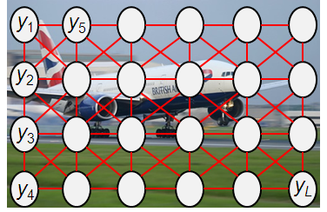
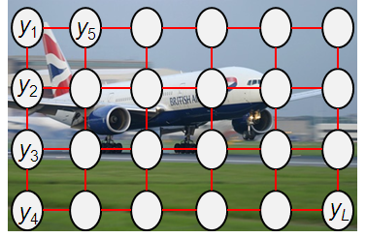
Complexity of Graphical Models
A graphical model defines family of distributions
4-neighbor pairwise model
Higher-order model
Notes:
-A graphical model defines a family of distributions and some families are larger than others.
-The denser/more complex the underlying graph structure is, the richer the set of dependencies we can model
-For example, the higher order model on the left is larger family of distributions than 4-neighbor model: can describe any distribution represented by the 4-neighbor model on the right

Slide 6
Are richer models more accurate?
Total error
Inference error
Error
Model error
Model Complexity
Notes:
-Unfortunately, increased representational power does not guarantee better predictions
-Trade-off between the accuracy achieved by a model and the computational resources needed to realize the benefit of that model
-It is not simply true that richer models are more accurate, but have higher computational complexity.
-Instead, the expressive power of a model must be balanced with the inferential complexity of a model – might in fact be diminishing returns if model is too complex
In particular, the total error in red under a model is determined by two components.
Model Error – ability of model to capture real-world phenomena.
Simple models do not approximate true (unknown) distribution well; while complex models can approximate true distribution accurately
Inference, even approximate, is intractable in most graphical models.
As a result, inference algorithms introduce approximations.
Error of an inference algorithm tends to be smaller in simple models and larger in richer, more complex models
Plot shown considers a

Slide 7
Thesis Statement
Advocate a “bottom-up” approach to approximate inference & learning
Start with simple, cheap approximation
Improve through additional computation

Slide 8
The “Bottom-up” approach
Computational Limit
Algorithm A
Error
Model Complexity
Notes:
Central concept of this thesis is to take a “bottom-up” approach to inference and learning in graphical models
Where we start with a simple, cheap

Slide 9
The “Bottom-up” approach
Computational Limit
Error
Algorithm B
Model Complexity

Slide 10
The “Bottom-up” approach
Computational Limit
Error
Algorithm C
Model Complexity

Slide 11
Overview of Thesis
Max Likelihood Learning
Computation-limited, approximate learning
Computing Marginal Probabilities
Region choice for Generalized Belief Propagation
Most Probable (MAP) Configuration
Cutting-plane algorithm for weighted matchings
Notes:
-In my thesis I studied the bottom-up approach in three different settings
-First was the problem of learning the parameters of a graphical model via maximum likelihood
- max likelihood learning of graphical models is not possible in problems where inference is intractable.
- In such settings, it is common to use approximate inference and maximize the so-called 'surrogate‘ likelihood
- we studied the effect of using different approximate inference methods and, therefore, different surrogate likelihoods, on the accuracy of parameter estimation and prediction
-Second was the problem of computing marginal probabilities
- GBP is an approximate inference algorithm that builds upon Loopy BP
- BP passes message between nodes of the graphical model; is a fully defined algorithm given a graphical model
- GBP clusters nodes together into regions and passes messages between regions; is not well defined as many region clusterings are possible
- we propose a new criteria tree-robustness for choosing collection of clusters comprising a GBP approximation
- connect problem of choosing regions to that of finding cycles in forming a fundamental cycle basis
-Third, we investigated problem of finding the most probable configuration of a model
- focused on a specific combinatorial optimization problem – the weighted matching problem – and a particular MAP inference algorithm – max product BP
- Our focus on the max-product BP algorithm is due to some recent results showing that it is provably exact for certain loopy graphical models
- performance of BP in matching problems can be characterized by properties of the LP relaxation, i.e. zero integrality gap
- when integrality gap exists, BP is no longer provably exact
- integrality gap can be close by adding so-called blossom constraints
- if added naively, will ruin exactness of BP

Slide 12
Outline of this Talk
Max Likelihood Learning
Sources of error in likelihood-based learning
Computation-accuracy trade-offs in approximate learning
Computing Marginal Probabilities
Review of Belief Propagation (BP) & Generalized BP
Choosing Regions via Cycle Bases
Summary

Slide 13
Outline of this Talk
Max Likelihood Learning
Sources of error in likelihood-based learning
Computation-accuracy trade-offs in approximate learning
Computing Marginal Probabilities
Review of Belief Propagation (BP) & Generalized BP
Choosing Regions via Cycle Bases
Summary

Slide 14
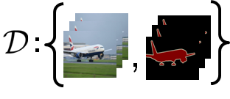
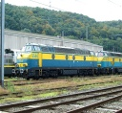
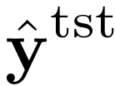
Parameter Estimation & Prediction
Training Data:
Test Point:
Estimation
Prediction
Model:
Notes:
Given a set of training data and a model (e.g. a pairwise w/ 4 neighbor connectivity),
first estimate the parameters of the model
Find maximum likelihood estimate: parameter setting that maximizes the probability of training data under the model

Slide 15
Parameter Estimation & Prediction
Training Data:
Test Point:
Estimation
Prediction
Model:
Notes:
use the learned model to make predictions on an unseen test data point

Slide 16
Max Likelihood Estimation
Given a model, ,
find
where,
vector of empirical marginals:
Notes:
-Use maximum likelihood estimation to find an estimate of \theta given some i.i.d. training data
-\ell_N \theta is jointly concave function – first term is linear in \theta and \log partition function is convex function of \theta
- can in principle be optimized by any convex optimization method
however, evaluating \log Z requires inference, which means that even evaluating \ell_N requires inference
In addition, the gradients of \ell_N require computing marginals under p(y ; \theta)

Slide 17
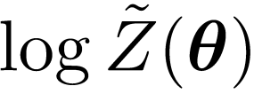
Surrogate Likelihood [Wainwright ‘06]
Approximate is with ,
Notes:
-Since exactly computing logZ is intractable we must approximate it
-The surrogate likelihood function arises by choosing an approximate inference method, e.g. loopy BP, and plugging the approximation to the log-partition function, \tilde logZ, into the expression for the log-likelihood
-Different choices of approximate inference yield different surrogate likelihood functions,
-And some of these surrogates will approximate the true likelihood function better than others

Slide 18
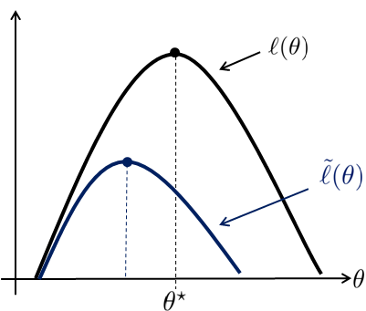
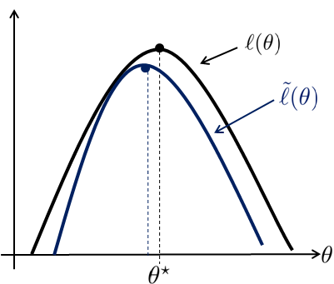
Surrogate Likelihood [Wainwright ‘06]
Approximate is with ,
Low iBound
High iBound
,…,
Notes:
In keeping with the theme of the thesis we are interested in adding computation, in a bottom up fashion, to improve upon the quality of the surrogate
Shown on the left is a low computation

Slide 19
Surrogate Likelihood [Wainwright ‘06]
Approximate is with ,
Low iBound
High iBound
When does better inference mean better learning?
,…,
Notes:
In keeping with the theme of the thesis we are interested in adding computation, in a bottom up fashion, to improve upon the quality of the surrogate
Shown on the left is a low computation

Slide 20
Errors in Approximate Learning
Model Error
Error in approximation to true (unknown) distribution
Estimation Error
Error due to use of finite sample
Optimization Error
Gap between true and surrogate likelihood functions
Notes:
The gap between the surrogate and true likelihood is not the only source of error in inference-based parameter estimation.
In practice, we are given a finite sample of data drawn independently from some unknown probability distribution.
This introduces two additional sources of error: model error and estimation error which we now review

Slide 21
Errors in Approximate Learning
Model Error
data sampled as , where
fit model with
e.g. pairwise models
Err_{model}
Notes:
First, since the data generating process is unknown, we assume a convenient often (restrictive) form for our model,
This which may introduce model error.

Slide 22
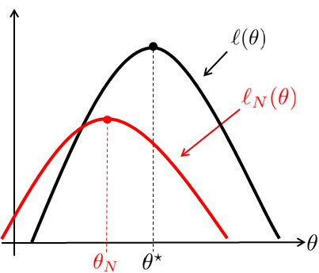
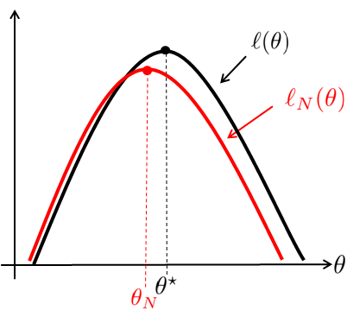
Errors in Approximate Learning
Estimation Error
optimize empirical (not expected) risk
small N
large N
,…,
Notes:
Second, there is estimation error due to the fact that we are using a finite sample from the unknown distribution and optimizing an empirical estimate of the true likelihood function.

Slide 23
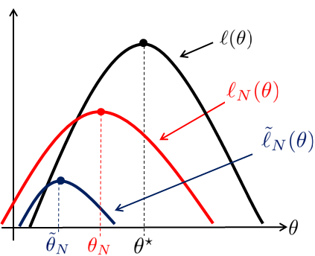
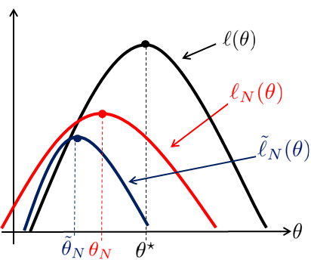
Errors in Approximate Learning
Optimization Error
optimize a surrogate likelihood
surrogate A (poor)
surrogate B (better)

Slide 24
Empirical Study (I) – Estimation
Data:
Estimation
Model:
Study estimation error (MSE) as we vary:
Optimization Error: inference procedures
Estimation Error: data set size
Model Error: mismatch between and
Notes:
These different sources of error will interact in various ways. In some cases the estimation error may be relatively large so that reducing optimization error may be inconsequential to the total error; in other cases, say for large data, the optimization error may indeed be significant and we might see a benefit from increasing our computational budget
We conducted a large empirical evaluation to systematically study these different sources of error and identify regimes where it is benefcial to invest more
computation and optimize a better surrogate to the true likelihood.
We begin with a set of synthetic experiments where we can control the level of model and estimation error in our learning problem

Slide 25
Experimental Setup
Create L statistically identifiable models
Sample and for
Sample data sets of size N = {100,…,10000}
Find
Using different approximate inference algorithms

Slide 26
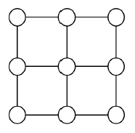
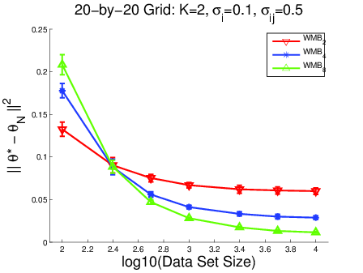
Grid Experiments
WMB₂
WMB₄
WMB₈
Notes:
Results for a set of L=25 random binary MRFs on 20-by-20 grids in standard 4-neighbor connectivity.
No model error, so model used to generate data is same family as model being learned
In this case as we move from WMB 2 in red, to WMB 4 in blue to WMB 8 in green, the computational budget is increased
Similarly, as we move from BP in magenta to GBP in cyan, the budget is also increased
Note that the MSE decreases for all methods as the data set size is increased – in other words, as N increases estimation error is reduced
When N is large, the only error that remains is due to the difference between the surrogate and exact likelihood functions
In this case we see the expected result that higher ibound inference gives better parameter estimates (e.g. green line versus red line)
In contrast, when N is small, we see that investing additional computational resources may be injurious.

Slide 27
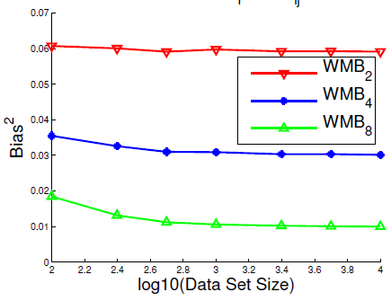
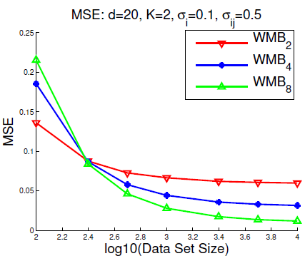
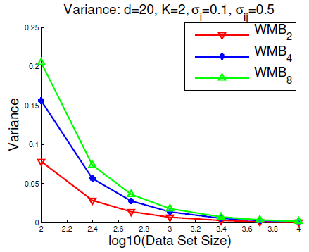
Bias–Variance Trade-off
=
+
Notes:
The previous experiment suggested that lower iBound methods are (on average) more accurate than higher iBound methods in the small data setting.
However, as N is increased our intuition that higher iBound methods have asymptotically smaller bias was also confirmed.
In other words, it appears that lower iBound methods trade larger bias for reduced variance, while higher iBound methods trade smaller bias for increased variance.
Conducted a simple experiment to expose this trade-off.
Fix \theta^\star on a 20-by-20 binary grid
Generate L=25 data sets of different sizes under this model, for N = 100,250,…10000
Optimize surrogates arising from different approximate inference methods on all of these data sets
Compute the bias and variance across these parameter estimates
Our intuition is indeed correct. The MSE on the left decomposes into bias^2 and variance on the right. Note that the bias for the higher iBound WMB-8 method is lower than the other lower iBound methods. However, the variance of the WMB-8 estimator is much larger than the WMB-2 estimator for small N.
In other words, even the variance of all of the inference-based estimators decrease as N grows, he rate at which it decreases differs

Slide 28
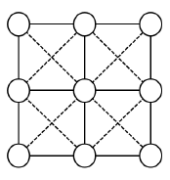
Model Error Experiments
Generate
Estimate
where
where
Notes:
Also consider an experiment in which there is model error.
Generate our data from a pairwise grid with 8-neighbor connectivity, but learn a model with only 4-neighbor connectivity
Pairwise potentials on the new diagonal edges are drawn from Normal(0; \sigma_{ik}^2) and we increase \sigma_{ik} from 0 to 1 to increase
the level of model error is incrased
On the left is a plot for N=100 data points; on the right is a plot using N=10000 data points
Notice that the WMB-2 method has flipped from having smallest error to having the worst error; flips from being most robust to least robust
Once again, it seems that the variance reduction in small data sets plays a role.

Slide 29
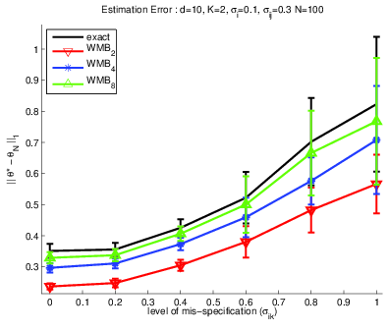
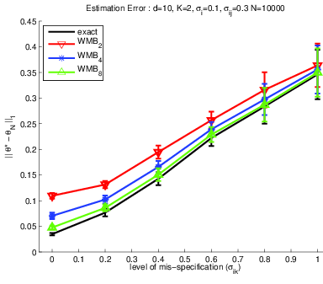
Model Error Experiments
N=100
N=10000
Increasing amount of mis-specification
Notes:
Also consider an experiment in which there is model error.
Generate our data from a pairwise grid with 8-neighbor connectivity, but learn a model with only 4-neighbor connectivity
Pairwise potentials on the new diagonal edges are drawn from Normal(0; \sigma_{ik}^2) and we increase \sigma_{ik} from 0 to 1 to increase
the level of model error is incrased
On the left is a plot for N=100 data points; on the right is a plot using N=10000 data points
Notice that the WMB-2 method has flipped from having smallest error to having the worst error; flips from being most robust to least robust
Once again, it seems that the variance reduction in small data sets plays a role.

Slide 30
Empirical Study (II) – Prediction
Test Point:
Prediction
Estimate:
Typically don’t know , compute
Hamming Loss:
Notes:
In this section, we focus on the prediction task and study the effect of using different inference methods on prediction accuracy.
In other words, rather than focusing on how well we can learn the parameters of a model, we focus on how accurately we can predict under the learned model.
First estimate the parameters of our model, on a training set and then appeal to Bayesian decision theory to construct a prediction rule appropriate for our choice of loss function. Max-marginals for hamming loss;

Slide 31
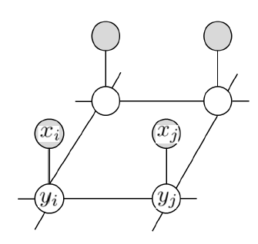
MRF De-Noising Experiments
USPS digits data (1100, 16x16 pixel grayscale images)
Convert to binary and flip pixels with probability p
Assume a 4-neighbor model:
Compute both Err_{est} and Err_{pred}
Err_{est} computed wrt (using exact inference)

Slide 32
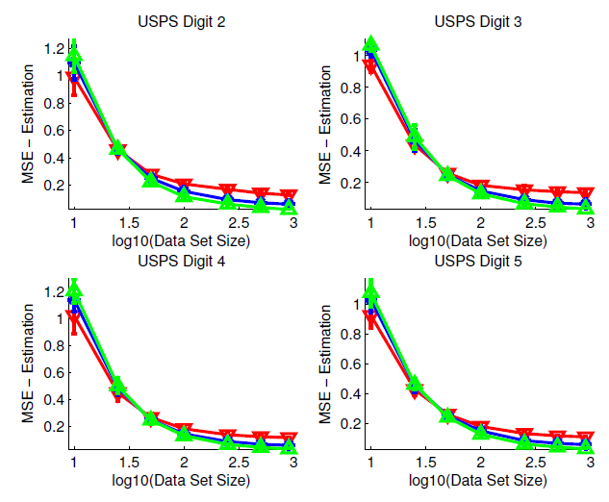
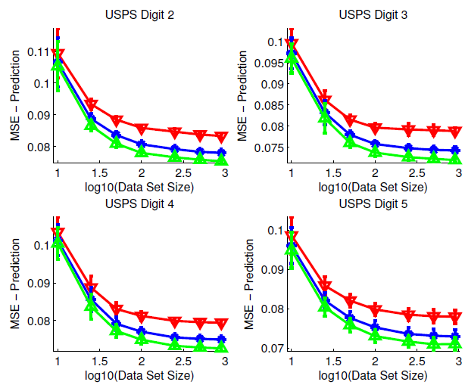
MRF De-Noising Experiments
Estimation Error
Prediction Error
WMB₂
WMB₄
WMB₈
Notes:
Left: estimation error on digits 2-5.
- For small N, the reduced variance of the WMB2 estimator lead to smaller estimation error than the higher iBound methods
Right: prediction error on digits 2-5.
- inference method used to estimate \theta was also used to compute the marginals needed for prediction - i.e., if WMB2 was used in learning, then WMB2 was also used in prediction.
The prediction error for all of the methods decreases as N is increased as we would hope.
However, we see that the prediction error of higher iBound methods is consistently less than the error of lower iBound methods.
This is quite interesting given that the higher iBound methods had larger estimation error for small N.
In other words, it seems that the error introduced by having the wrong parameters is far less important for prediction accuracy than the error introduced by computing the wrong (or approximate) marginals on the model.

Slide 33
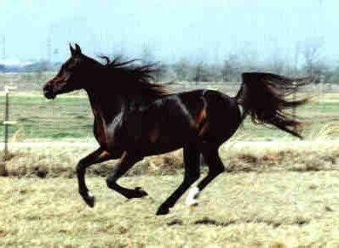
Foreground/Background Segmentation
Input, x
Output, y
Notes:
We also considered a simple problem from computer vision, where one takes an RGB image with L pixels as input and wishes to predict a foreground-background labeling as output.
In particular, we consider the collection of 328 images from the Weizmann horse database.
Each image in this data set contains a horse in some natural setting and our objective is to predict if each pixel i in an image is part of a horse (yi = 1)
or is background (yi = 0).

Slide 34
Foreground/Background Segmentation
Input, x
Output, y
Notes:
Since the images are irregularly sized and typically quite large, we randomly sample 40-by-40 patches from the images.
In particular, we create a training set of 500 patches by first choosing one of the 200 training images at random and then randomly choosing a fully-labeled patch within that image.
The test set is constructed in a similar fashion, but we randomly sample a total of 200 patches from the 128 test images instead

Slide 35
Conditional Random Field Model
Unary Features:
y₁
y₅
y₂
y₃
Pairwise Features:
y₄
y_{L}
Notes:
-We fit a conditional random field model comprised of:
- unary features that integrate local color/texture information at pixel I
- Pairwise features that capture correlations between neighboring pixels, e.g. pixels taking same label if color difference is less than some threshold

Slide 36
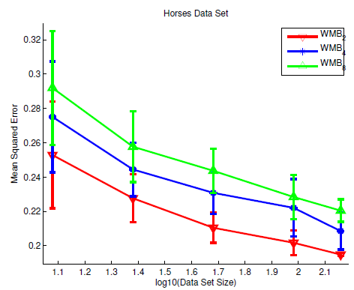
Quantitative Results
Prediction Error
Notes:
Surprisingly, we see that training and predicting with the WMB-8 method yields greater error than training and predicting with lower iBound methods
Even worse, it requires greater amount of training time

Slide 37
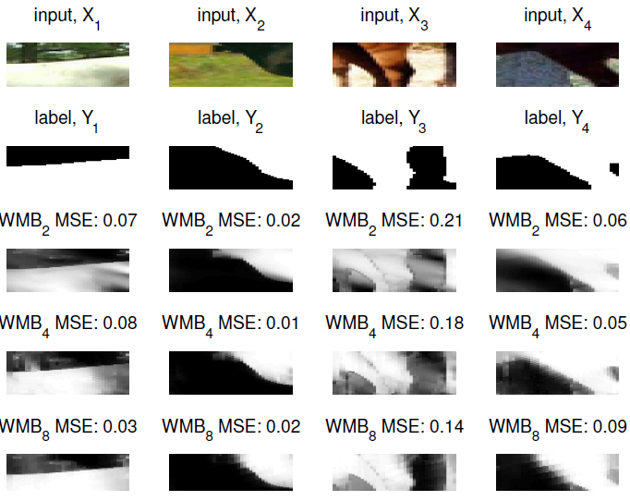
Qualitative Results
WMB₂
WMB₄
WMB₈
Notes:
Predicted marginals for several test patches.
Each column depicts the input patch, the true labeling and the marginals predicted by the WMB2, WMB4 and
WMB8 methods, respectively.
These patches qualitatively demonstrate the difference between the predictions made by each of the methods.
Smoothness of WMB-8 is evident in input 4

Slide 38
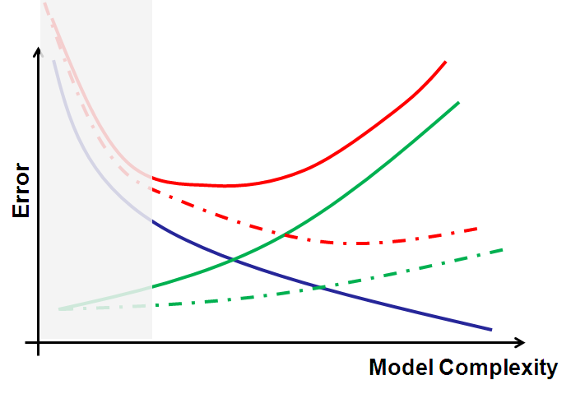
Summary of Experimental Study
If data set is small use a lower iBound method
Trade smaller variance for increased bias
Higher iBound does
not yield better
predictions if model
error is dominant
Model Error Dominant

Slide 39
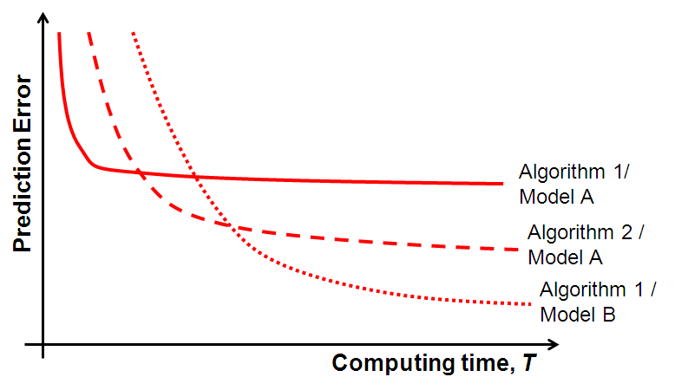
The Dream Scenario…
Given data set N and time budget T, choose the model and algorithm that minimize test error
(For a fixed N)

Slide 40
Outline of this Talk
Max Likelihood Learning
Sources of error in likelihood-based learning
Computation-accuracy trade-offs in approximate learning
Computing Marginal Probabilities
Review of Belief Propagation (BP) & Generalized BP
Choosing Regions via Cycle Bases
Summary

Slide 41
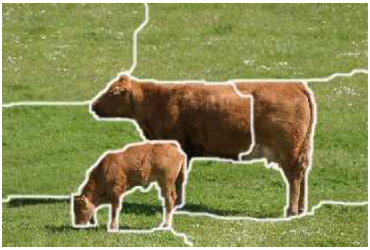
Computing Marginals
After learning
y₂
…want to compute:
y₁
?
y₄
y₅
y₃
y₆
?
y₈
y₁₀
y₉
y₇
y₁₁
Notes:
We start by considering the task of computing marginal probabilities under our model
For example, say we are a given the following pairwise model of an image segmentation
Each variable is associated with a particular label, e.g. ‘grass’ or ‘cow’, and rather than computing the most likely
Segmentation we want to compute the marginal probability of each segment

Slide 42
Variational Perspective [Wainwright & Jordan ‘08]
Convert from a summation task…
…to an optimization task
Set of valid probability distributions
Entropy of distribution b(y)
Notes:
The framework of variational inference converts computation of the log-partition function and marginals from a summation task to an optimization problem. Although this optimization problem is intractable, it suggests a way to create approximations by relaxing the problem's constraints and approximating the entropy term appearing in the problem's objective function.

Slide 43
Variational Approximations
GBP introduces two approximations
1) Locally consistent beliefs
2) Approximate Entropy
Marginal Entropy on Region R, where
Notes:
In particular, GBP introduces the following two approximations. First, rather than searching over the space of valid probability distributions, we search over the space of locally consistent beliefs. Second, we replace the true entropy with the Kikuchi approximation, which approximates the exact entropy by a weighted sum of marginal entropies. Each marginal entropy is computed over a subset of variables Y_R called a region

Slide 44
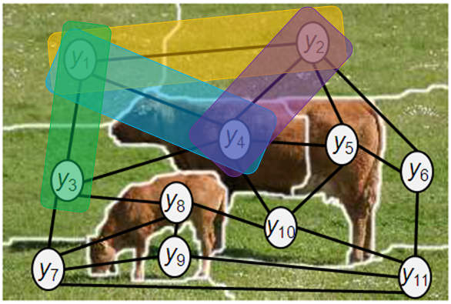
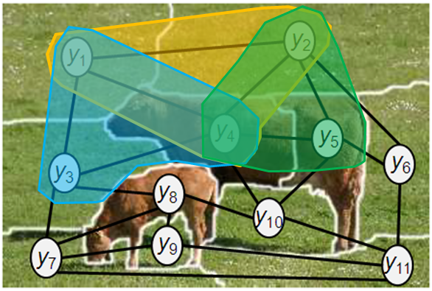
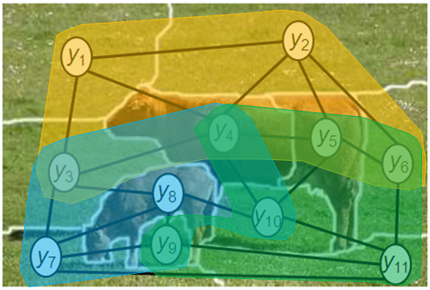
Which Regions do we choose?
Bethe / BP
Kikuchi / GBP
Exact
Complexity:
exp(2)
exp(|region|)
exp(w*)
Accuracy:
low
high
exact
Notes:
The main motivation behind clustering the nodes of a model is that if we can convert a loopy graphical model into an equivalent tree-structured graphical model, then we can directly utilize the BP updates to compute exact marginals.
Unfortunately, we cannot always find an equivalent tree-structured graphical model for which the marginal computations are tractable.
GBP relaxes the requirement of finding an equivalent tree-structured model and instead finds an equivalent model on a loopy graph.
By grouping the variables into clusters we can find an equivalent model that is more tree-like than the model on which Loopy BP operates, but
maintain tractability by limiting the size of the largest cluster considered.
The hope is that as we move from loopy BP on the left to exact inference on the right and increase our computational budget, we can steadily increase the accuracy of our approximation.

Slide 45
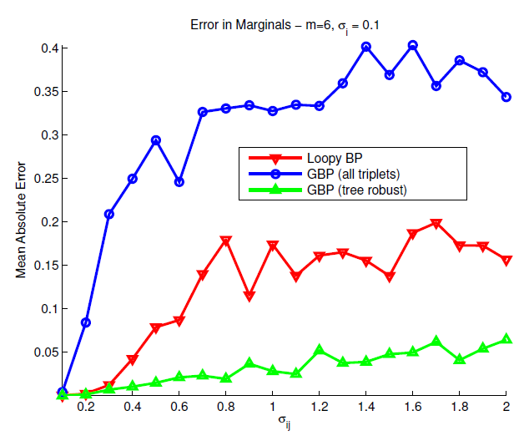
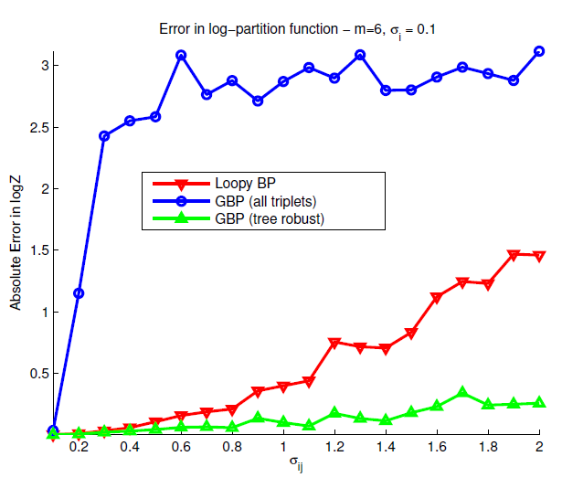
Region choice is important!
Error in marginal estimates
Error in log Z estimates
Same complexity; very different accuracies!
Notes:
Unfortunately, great care must be taken when choosing regions as GBP is very sensitive to the choice of clusters used: a bad choice can
lead to poor convergence and marginals estimates that are worse than Loopy BP, while a good choice can lead to rapid convergence and accurate estimates.
The left and right figures show the error in the marginal estimates and log-partition function for three different collections of regions.
Inference in the model becomes harder as we move from left to right.
Loopy BP's estimates are shown in red
A good choice of regions is shown in green and a poor choice is shown in blue
These results are for a pairwise model on K_6. The GBP approximation shown in blue utilizes all 20 clusters of size 3 in the model of 6 variables, while the GBP approximation in green utilizes a specific subset of 10 of these clusters. Clearly, utilizing all of the clusters is a bad choice and leads to estimates that are
actually worse than loopy BP.

Slide 46
Existing Guidance on Region Choice
Choose Regions so that:
exact when p(y) nearly uniform
exact when p(y) nearly deterministic
All fixed points are uniform when p(y) is uniform
[Yedidia, Freeman, Weiss ’02]
[Pakzad & Anantharam ‘05]
[Yedidia, Freeman, Weiss ’02]
[Welling, Minka, Teh ‘05]
Notes:
Much of the existing guidance on choosing regions has focussed on the entropy approximation.
In particular, Yedidia Freeman and Weiss as well as Pakzad and Anantharam proposed that the entropy approximation should be exact when the target distribution is uniform.
In addition, YFW suggest that the entropy approximation also achieve its maximum when the target distribution is uniform – a property that would clearly be satisfied by the true entropy
In addition, YFW suggest that the entropy be exact when the target distribution has two equi-probable states
Last, WMT suggest that the fixed points of message passing be uniform whenever the target is uniform
All of these recommendations act at two ends of the spectrum: either assume that the distribution is nearly uniform or nearly deterministic

Slide 47
Tree-Robustness [Gelfand & Welling ‘12]
Consider a pairwise model
y₂
y₁
y₄
y₅
y₃
y₆
y₈
y₁₀
y₉
y₇
y₁₁
Notes:
We proposed a new selection criteria -- tree-robustness -- which works as follows:

Slide 48
Tree-Robustness [Gelfand & Welling ‘12]
Consider a pairwise model
Let be a tree in G
y₂
y₁
y₄
y₅
y₃
y₆
y₈
y₁₀
y₉
y₇
y₁₁

Slide 49
Tree-Robustness [Gelfand & Welling ‘12]
Consider a pairwise model
Let be a tree in G
Assume uniform off-tree factors:
y₂
y₁
y₄
y₅
y₃
y₆
y₈
y₁₀
y₉
y₇
y₁₁

Slide 50
Tree-Robustness [Gelfand & Welling ‘12]
Consider a pairwise model
Let be a tree in G
Assume uniform off-tree factors:
is exact on and all such trees in G!
y₂
y₁
y₄
y₅
y₃
y₆
y₈
y₁₀
y₉
y₇
y₁₁

Slide 51
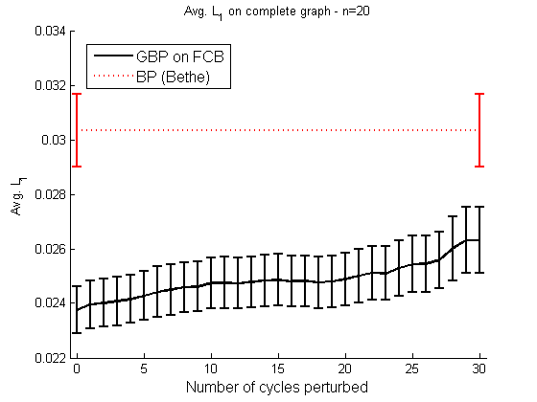
Is Tree Robustness Desirable?
Accuracy degrades as Regions becomes less Tree Robust!
Tree Robust
Less Tree Robust
Notes:
Importantly, in this chart as we make our approximation less tree robust we still satisfy the existing guidance on region choice – i.e. exactness of entropy approx when p(y) uniform, exactness of entropy approx when p(y) has two equi-probable states, all fixed points uniform when p(y) uniform,

Slide 52
Bottom-Up Region Selection
Selecting Regions ≡ Finding Cycle Bases in G
pairwise model
graph, G
y₁
y₂
y₁
y₂
y₃
y₄
y₃
y₄
Notes:
So how exactly do we find good regions?
connected the problem of choosing the loop outer regions of a Loop-Structured Region Graph (Loop-SRG) to that of finding a fundamental cycle basis
of the undirected graph underlying a pairwise graphical model.
If collection of outer regions comprise a fundamental cycle basis give GBP approximations
that behave sensibly when the factors dening a model are extremely weak (non-Singularity)
and extremely strong (over-counting number unity) and demonstrated the eectiveness of
this recommendation empirically.
First characterize

Slide 53
Bottom-Up Region Selection
Selecting Regions ≡ Finding Cycle Bases in G
pairwise model
graph, G
C₁
y₁
y₂
y₁
y₂
y₁
y₂
y₃
y₄
y₃
y₄
y₃
y₄
Notes:
connected the problem of choosing the loop outer regions of a Loop-Structured Region Graph (Loop-SRG) to that of finding a fundamental cycle basis
of the undirected graph underlying a pairwise graphical model.
If collection of outer regions comprise a fundamental cycle basis give GBP approximations
that behave sensibly when the factors dening a model are extremely weak (non-Singularity)
and extremely strong (over-counting number unity) and demonstrated the eectiveness of
this recommendation empirically.
First characterize

Slide 54
Bottom-Up Region Selection
Selecting Regions ≡ Finding Cycle Bases in G
pairwise model
graph, G
C₁
C₂
y₁
y₂
y₁
y₂
y₁
y₂
y₁
y₂
y₃
y₄
y₃
y₄
y₃
y₄
y₄
Notes:
connected the problem of choosing the loop outer regions of a Loop-Structured Region Graph (Loop-SRG) to that of finding a fundamental cycle basis
of the undirected graph underlying a pairwise graphical model.
If collection of outer regions comprise a fundamental cycle basis give GBP approximations
that behave sensibly when the factors dening a model are extremely weak (non-Singularity)
and extremely strong (over-counting number unity) and demonstrated the eectiveness of
this recommendation empirically.
First characterize

Slide 55
Bottom-Up Region Selection
Selecting Regions ≡ Finding Cycle Bases in G
pairwise model
graph, G
C₁
C₂
C₃
y₁
y₂
y₁
y₂
y₁
y₂
y₁
y₂
y₁
y₂
y₃
y₄
y₃
y₄
y₃
y₄
y₄
y₃
Collection of outer regions
Notes:
connected the problem of choosing the loop outer regions of a Loop-Structured Region Graph (Loop-SRG) to that of finding a fundamental cycle basis
of the undirected graph underlying a pairwise graphical model.
If collection of outer regions comprise a fundamental cycle basis give GBP approximations
that behave sensibly when the factors dening a model are extremely weak (non-Singularity)
and extremely strong (over-counting number unity) and demonstrated the eectiveness of
this recommendation empirically.
First characterize

Slide 56
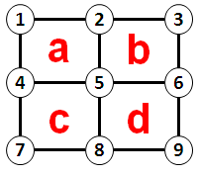
Identifying Tree-Robust Regions
Selecting TR Regions ≡ Finding TR Cycle Basis
Faces of a planar graph:
‘Star’ Construction
1
2
2
3
4
5
5
6
a
b
c
d
4
5
5
6
7
8
8
9
1
2
1
2
1
2
1
a
1
2
c
b
3
4
3
4
4
3
4
3

Slide 57
Experimental Results
Grids with long range interactions
Algorithms
GBP with Tree-Robust Core
GBP with ‘ear’ construction
Loopy BP
Iterative Join Graph Prop. (IJGP) w/ iBound = 4

Slide 58
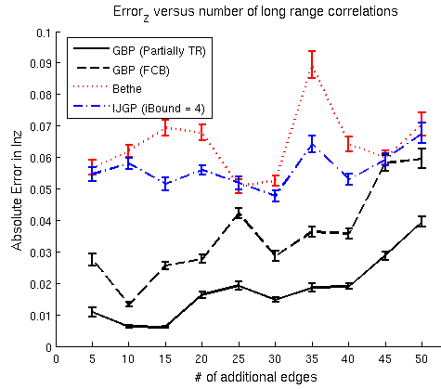
Experimental Results
Error in marginal estimates
Error in log Z estimates
Increasing # of non-planar edges

Slide 59
Outline of this Talk
Max Likelihood Learning
Sources of error in likelihood-based learning
Computation-accuracy trade-offs in approximate learning
Computing Marginal Probabilities
Review of Belief Propagation (BP) & Generalized BP
Choosing Regions via Cycle Bases
Summary

Slide 60
Summary
Continued need for better inference methods
Advocate a “bottom-up” approach to inference
Computation-Accuracy Trade-offs in Learning
Small N => Low computation inference
Better inference does not mean better predictions
Proposed tree-robustness for choosing regions
Connected finding regions to finding cycle bases

Slide 62
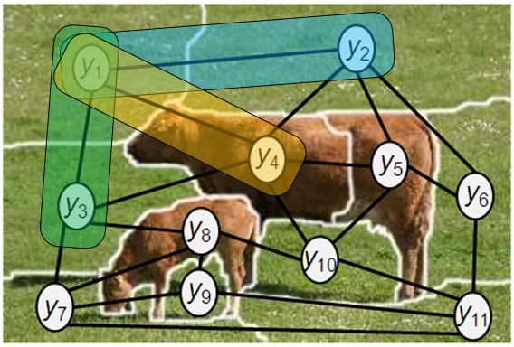
Belief Propagation (BP) [Pearl ‘88]
y₁
y₂
y₁
y₃
y₁
y₄
y₁
y₂
y₃
y₄
Notes:
Belief propagation (BP) is a classic algorithm developed by Pearl for performing marginal inference in bayesian networks
BP is a simple, distributed algorithm that passes messages between the nodes of a graphical model.
When the model is tree-structured, the BP algorithm requires just two iterations to compute the exact marginals of the input distribution, p(y).
When the network is not tree-structured, then BP is no longer exact.
We can nonetheless apply the BP message-passing updates to the loopy model.
The result is an iterative, approximate inference algorithm known as Loopy BP that has proven to be quite effective in practice

Slide 63
Belief Propagation (BP) [Pearl ‘88]
y₁
y₂
y₁
y₃
y₁
y₄
y₁
y₂
y₃
y₄
Notes:
BP approximates p(y) in a distributed fashion.
Each edge and variable are associated with a local probability distribution.
BP message updates can be interpreted as ‘corrections’. For example, the message in red sent from edge 1-2 to node 1 ensures that the belief b_1(y_1) at node 1 is consistent with the marginal of belief on edge 1-2.

Slide 64
Belief Propagation (BP) [Pearl ‘88]
y₁
y₂
y₁
y₃
y₁
y₄
y₁
y₂
y₃
y₄
Iterate until beliefs are consistent !
Notes:
We continue iterating in this fashion until all the beliefs are consistent.
We can then treat the beliefs at each node as approximations to the marginal probabilities.

Slide 65
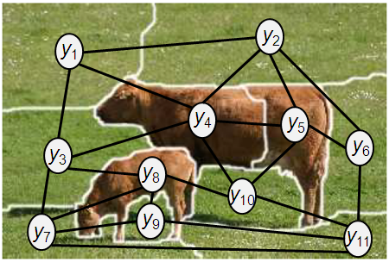
Generalized BP [Yedidia, Freeman, Weiss ‘00]
Notes:
Generalized Belief Propagation (GBP) is a broad class of approximate inference algorithms that extends BP by grouping the network's nodes into clusters and (iteratively) passing messages between the clusters of variables.

Slide 66
Generalized BP [Yedidia, Freeman, Weiss ‘00]

Slide 67
Generalized BP [Yedidia, Freeman, Weiss ‘00]

Slide 68
Generalized BP [Yedidia, Freeman, Weiss ‘00]
y₂
y₁
y₂
y₁
y₄
y₄
y₃
y₄
y₅
y₁
y₄
y₂
y₄
y₁
y₂
y₃
y₄
Notes:
Factors are allocated to regions
Each region has an associated local probability distribution or belief, e.g. the triplet of variables y_1,y_2,y_4 has a belief b_124
In addition, each region has a particular structure that governs how the local distribution factors.
We will assume that all outer regions, i.e. those with no parents, are loop-structured.
Regions are connected by constraints which ensure consistency between regions, e.g. the belief over region in yellow on variables 1,2,4 must agree with the belief of the blue region over variables 1-3-4 on the joint belief over variables 1 and 4
Correction messages are passed between regions until all consistency constraints are satisfied

Slide 69
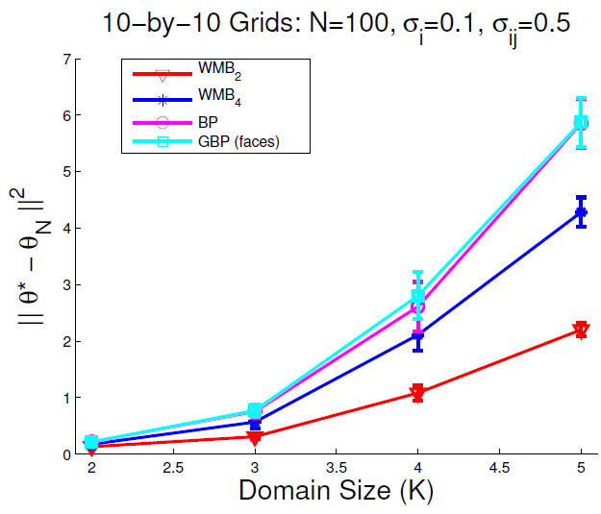
Domain Size Experiments
Notes:
We also considered a set of experiments to see how the MSE/error scales as the domain size of the variables in our model is changed
In particular, we generated 8 different models on 10-by-10 grids and increased the domain size of the variables in the model from 2 up to 5
This plot shows the error of using different approximate inference methods as a function of domain size for a data set of size N =100
Note that the WMB 2 method in red lies below the WMB 4 method in blue, which requires more computation
The gap also increases as domain size is incrased

Slide 70
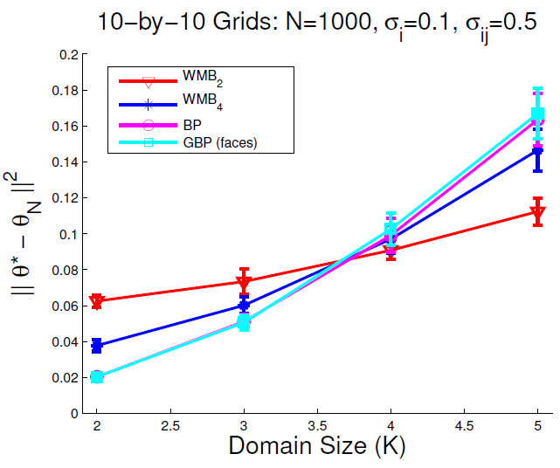
Domain Size Experiments
Notes:
Note the shift in behavior as data set size N is increased to 1000
At this point, the WMB-4 method is below the WMB-2 method for domain sizes of 2 and 3

Slide 71
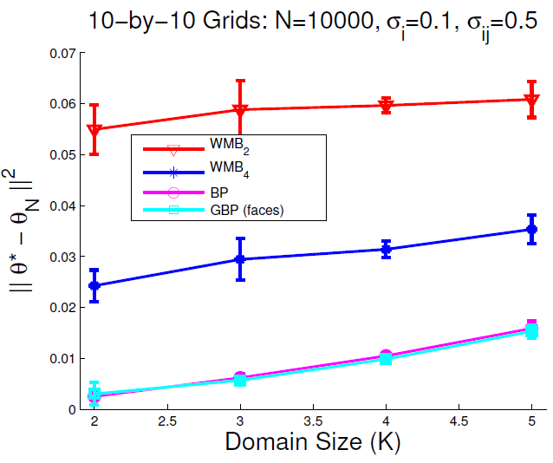
Domain Size Experiments

Slide 72
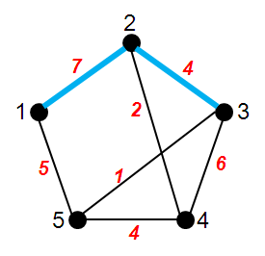
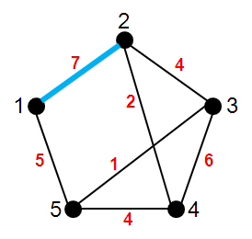
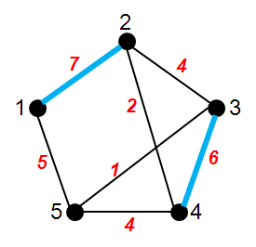
Weighted Matching Problem
Given graph G=(V,E) with edge weights
find a matching of total maximum weight
Matching: subset of E, such that no 2 edges share a vertex
Not a Matching
Valid Matching
Max Weight Matching

Slide 73
Solving Weighted Matching Problems
Many efficient algorithms exist
Recent results using Belief Propagation
Edmonds | 1965 | O(|V|² |E|)
Lawler | 1973 | O(|V|³)
Gabow | 1974 | O(|V|³)
Galil, Micali, Gabow | 1986 | O(|V||E| log|V|)
Gabow | 1990 | O(|V|(|E|+|V|log|V|))
Bayati, Shah, Sharma [bipartite graphs] | 2005 | O(c |V|³)
Sanghavi,Malioutov, Willsky [general graphs] | 2007 | O(c w^{max}|V|³)
Notes:
Matchings have a rich 30 year history in CS research, partly because of the elegance of the problem and Edmond’s original algorithm, but also because it appears as a sub-problem in many important applications, e.g. resource allocation, sensor management,…
Recent results are inspiring for two reasons:
first, BP is an easy to implement, naturally paraellizable, and distributed algorithm – meaning that it is practically useful
second, BP is an iterative message passing algorithm that is, in general, not guaranteed to converge, much less converge to exact solution
Typical analyses focus on characterizing fixed points, providing conditions for correctness
The performance of BP in these cases is characterized by properties of the linear programming relaxation of the matching problem, which I’ll discuss over the next few slides.

Slide 74
Solving Weighted Matching Problems
Matching problem as Integer Program (IP)
match-IP
match-IP as a MAP inference problem
Linear Programming (LP) Relaxation of match-IP
MAP-match
match-LP
Notes:
Matching problem is naturally cast as an integer programming problem, which are in general NP-hard
The IP formulation of the matching problem can be relaxed and formulated as a linear programming problem.
The LP formulation can lead to integrality gaps and thus fail to give the optimal, max weight matching.
Alternatively, the matching problem can be formulated as a MAP estimation problem in graphical models.
The max-product BP algorithm is a general purpose algorithm that is only guaranteed to give optimal answers on tree-structured graphs.

Slide 75
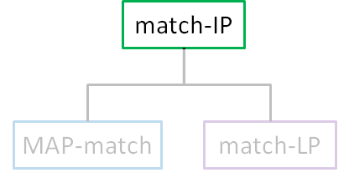
Matching as an Integer Program (IP)
Given graph G=(V,E) with edge weights
Vertex Incidence Constraint
Integrality Constraint
Together define matching polytope,
Notes:
X_e is an indicator if edge e is “in” the matching
Constraints ensure that at most one edge is incident to a given vertex

Slide 76
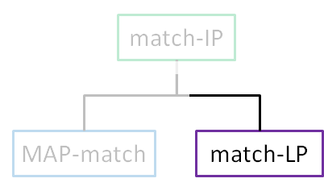
Linear Programming (LP) Relaxation
Given graph G=(V,E) with edge weights
Vertex Incidence Constraint
Relaxed Integrality Constraint
Define a relaxed matching polytope,
Notes:
X_e is an indicator if edge e is “in” the matching
Constraints ensure that at most one edge is incident to a given vertex

Slide 77
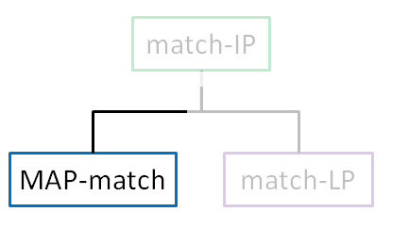
Matching as MAP Inference
Associate a variable with each edge
where
Edge weights
Vertex incidence constraints
Notes:
We pose the weighted matching problem as a MAP inference problem in the following graphical model.
We associate a binary variable with each edge and introduce unary functions that add weight w_e to the total when edge variable x_e is 1.
The local functions \theta_i enforce the constraint that at most one edge is adjacent to each vertex.
It is easy to see that any invalid matching will have a weight of minus infinity.
While any valid matching will have the same total weight as in the original matching integer program.
Thus, the match-MAP problem is equivalent to the match-IP problem.

Slide 78
Relationship between polytopes
Feasible Integral Vertices / Matchings
Feasible Fractional Vertices / Matchings

Slide 79
Relationship between polytopes
If integral solution to match-LP, then max-product BP on MAP-match is provably exact
bipartite graphs [Bayati, Shah, Sharma ‘05]
general graphs [Sanghavi, Malioutov, Willsky ‘07]
match-IP
BP
≡
MAP-match
match-LP

Slide 80
What if match-LP is loose?
Solution of match-LP is fractional

Slide 81
What if match-LP is loose?
Remove fractional solution by adding constraints

Slide 82
What if match-LP is loose?
Solution of match-LP with additional cutting plane constraint

Slide 83
Edmonds and Blossom Constraints
Matching polytope is also given by [Edmonds 65]:
All odd-sized subsets of V
Edges w/ both ends in S
Notes:
Matching problem has been extensively studied.
Importantly, the matching polytope – the set of feasible matchings on graph G – has the following description, where in addition to the vertex incidence constraints we have added blossom constraints, shown in red.
These blossom constraints “cut” fractional solutions occurring on odd-sized sets of vertices.

Slide 84
Edmonds and Blossom Constraints
Matching polytope is also given by [Edmonds 65]:
Subset of Size 3
Constraint:
Removes:
Notes:
Matching problem has been extensively studied.
Importantly, the matching polytope – the set of feasible matchings on graph G – has the following description, where in addition to the vertex incidence constraints we have added blossom constraints, shown in red.
These blossom constraints “cut” fractional solutions occurring on odd-sized sets of vertices.

Slide 85
Solving Weighted Matching Problems
Matching problem as Integer Program (IP)
match-IP
match-IP as a MAP inference problem
Linear Programming (LP) Relaxation of match-IP
MAP-match
match-LP
Bayati, Shah, Sharma [bipartite graphs] | 2005 | O(c |V|³)
Sanghavi,Malioutov, Willsky [general graphs] | 2007 | O(c w^{max}|V|³)

Slide 86
Overview of Results
Tightened Relaxation
match-IP
match-LP
match-LP_{t}
MAP-match
match-MAP-LP
match-MAP-LP_{t}
Notes:
Okay…so now we’ve been to every site on our road-map…
Importantly, we’ve shown that optima of the MAP LP relaxation correspond to optima of the LP relaxation of the matching problem.

